Slide 1

New Employee
TRAINING
OVERVIEW
CUSTOMIZABLE TOOL

Slide 2
Create a TRAINING OVERVIEW
BUILD THE TRAINING PLAN 1 WEEK PRIOR
TO START DATE OR SOONER
The following pages include a sample that you can customize to build your new employee training plan. With each new hire, you will need to make edits to each page to reflect their plan. Also, be sure to complete a new employee training plan that outlines all the required training for the position.
Establish a schedule for the first week in the office
An employee’s first week should include an introduction to the firm vision and goals, meetings with appropriate team members and any training (online or on the job) that will kick-start their success. Be sure to place these items on the calendar for the trainer and new employee to ensure that they take place. Given that the new employee will be starting work during their first week, be sure initial training supports any initial assignments they will complete.
ENSURE Employee SET-UP IS COMPLETE AT LEAST
2 DAYS PRIOR TO START DATE
Use the New Employee Onboarding Checklist to ensure that set-up and training for the new team member are complete prior to their start date.
Providing New Team Members an orientation to your firm, the industry (if applicable) and formal training plan will help reduce the time it takes for them to reach their full potential as a high performer. The following pages are a sample New Employee Training and Orientation guide that you can customize.

Slide 3

Welcome to FIRM NAME
YOUR LOGO HERE
<<Employee NAME’s>> Orientation & Training Plan Overview
Notes:
Updaet this page with your firm’s branding

Slide 4
ONBOARDING & TRAINING Overview
YOUR
LOGO HERE
1
FIRST WEEK: INTRODUCTION
2
FIRST MONTH: WEEKLY CHECK-INS
3
FIRST 90 DAYS: MONTHLY CHECK-INS
4
Next: QUARTERLY CHECK-INS
5
THEN: 1-YEAR ANNIVERSARY & REVIEW
OUR GOAL IS TO SUPPORT YOU BY PROVIDING AN ENGAGEMENT MODEL THAT CREATES
COMMON LANGUAGE CONTINUOUS CONNECTION CLEAR COMMUNICATION
Notes:
Update this page to reflect the check-in meetings you will have with a new employee. Adjust the number or timing to reflect what works best for you.

Slide 5
YOUR FIRST WEEK
The below is an overview of your first week at FIRM NAME. Individual meetings are on
your Outlook on your calendar and your training plan will show items covered each day.
YOUR
LOGO HERE
 | Day 1 | Day 2 | Day 3 | Day 4 | Day 5+
 | Orientation |  | Office & Position Training |  | On Job / Hands On
8 a.m. | Intro & Set-Up with NAME | Daily Check-In | Daily Check-In | Daily Check-In | Weekly Check-In
9 a.m. | Vision & Goals with CEO | Position Review with Team Members | Position Duties Training | Technology Training | Individual training set up per the training plan, regular completion of duties and check-in to support learning your new role
10 a.m. | Training Plan Review, Position Review & Form Completion
11 a.m.
12 p.m. | Team Lunch | Lunch with CEO | Lunch on Your Own | Lunch on Your Own
1 p.m. |  |  | Position Duties Training | Work Time
2 p.m. | Business Overview: Services, Clients, Fees, Team | General Office Training
 |  |  | Work Time
3 p.m.
4 p.m. | Finalize Office Set-Up & Wrap Up | Work Time |  | Technology Training
5 p.m.
Notes:
Update to reflect the employee’s first week. A simple way to do this is to simply take a snapshot of their calendar once all meetings are scheduled.

Slide 6
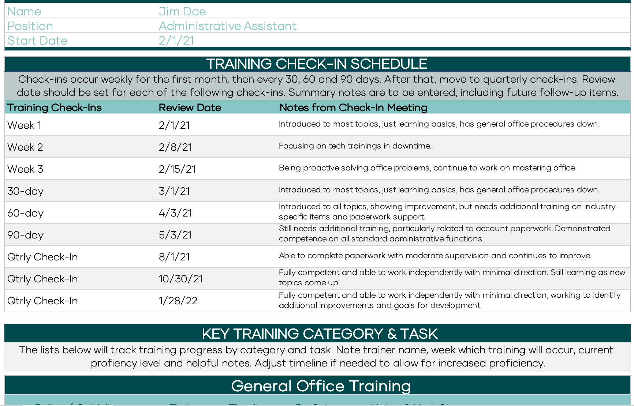
YOUR training plan
YOUR
LOGO
HERE
Notes:
Insert snapshot of their training plan here or keep template and hand them theirs.

Slide 7
Employee Forms checklist
COMPLETE EMPLOYMENT FORMS
  <List relevant forms here.
  Examples include W-4, I-9,
  NDA, Non-complete, etc. >
COMPLETE COMPLIANCE FORMS
  <Insert relevant forms here or delete this section>
REVIEW FIRM AND POSITION MATERIALS
  Employee Manual
  Job Description
  Training plan
  Firm website
  Firm vision & goals
Notes:
Update this with any necessary form sand materials for them to review

Slide 8
Additional Materials
Firm Vision
Service Model
Redtail Workflow list
20XX Annual Launch Plan
Etc.
YOUR
LOGO HERE
Notes:
Put any relevant materials past this page or list them here.

