Slide 1


Firm Compensation Plan
TEMPLATE
© Educe Inc. | Limitless Advisor
Limitless materials may not be reproduced, used, or sold in whole or in part, in any manner, without written consent or license for use by Educe, Inc.
Notes:
This document is a sample compensation plan that you can share use to design your firm compensation structure and then roll out the final model to your team. Note that some firms opt to include adviser positions in individual and firm incentive and other firms do not since a % of revenue has a similar impact.

Slide 2
FIRM COMPENSATION PLAN
Firm Philosophy & Reasoning
Comprehensive Compensation Package
Base & Benefits
Performance Incentives
What this Means to You

Slide 3
OUR FIRM PHILOSOPHY
Our philosophy regarding compensation is simple: we succeed as a team. Because of this, we reward our team members for those behaviors and attributes that contribute to our collective success.
OUR COMPENSATION PHILOSOPHY
Provide meaningful opportunities for compensation above industry standards
We believe that “you get what you pay for” and compensate team members for exemplary performance
Reward those who contribute to our success in an “above and beyond” way
High performance merits high compensation, not the other way around
HOW DO WE MEASURE SUCCESS?
  Quality
    Insert employee measures of success
    Team player mentality
    Communication
  Key performance metrics
    Annual goals & initiatives
    Client satisfaction
    Client retention
    Profitability
    Firm revenue
    Growth in assets under management
    New clients
Notes:
Update to reflect your firm comp philosophies.

Slide 4






A COMPREHENSIVE COMPENSATION PACKAGE
Compensation is only one way we reward true team players. In addition to compensation, we take a holistic approach to your benefits and perks package.
MONETARY COMPENSATION & BENEFITS
Base & Position Compensation
Variable Compensation
Above &
Beyond Recognition
FACTORS THAT IMPACT COMPENSATION:
  Roles and responsibilities
  Experience and qualifications
  Performance in the position
  Market conditions
  Ability to impact company performance
  Invested attitude/willingness to go above and beyond
  Interest, enthusiasm and passion
  Professional development
PERKS & BENEFITS
There Is More To Compensation Than Money
Perks
Opportunity
for Growth
Benefits
Eligibility: All full-time exempt team member are eligible for perks.

Slide 5
BASE / POSITION COMPENSATION
CRITERIA FOR DETERMINING
BASE / POSITION PAY
  Position type and employment status
  Knowledge, skills and experience related to position
  Competitive market pay
  Degree of variable compensation
  Ability to impact company performance
  Experience and qualifications
  Past contributions to the firm
ADVISOR / REVENUE-PRODUCING POSITIONS
  Base salary + % of revenue managed
  Associate Level: Base salary + bonus
TEAM POSITIONS
  Base salary (exempt)
  Hourly (non-exempt)
Notes:
Update this to reflect how you pay base or position compensation. The term position compensation is used because not all firms use base salary for revenue producing positions.

Slide 6
YOUR BENEFITS
POSITION SPECIFIC BENEFITS
FIRM-LEVEL BENEFITS
Annual employer match to 401k plan contributions
Insurance (Medical and Disability)
Development and training opportunities
Profit sharing program
DETAILS ARE AVAILABLE IN THE FIRM EMPLOYEE MANUAL AND BENEFITS PACKAGE
PAID TIME OFF
  15 days prior to 4 years, 5 days for each additional year
  Unlimited PTO upon 6+ years
Professional education reimbursement
  Payment and/or reimbursement for position-specific licenses, designations and training
Eligibility: Full-time, exempt employment and start date for benefits vary, but typically 90 days of employment is the minimum
Notes:
Update this to include the benefits you provide

Slide 7
PERFORMANCE INCENTIVES
Incentives are variable compensation designed to reward high-performing team players who contribute to our success and demonstrate long-term commitment. Incentives are not guaranteed compensation.
Eligibility: Full-time, exempt employment, at least six months with the firm and satisfactory job performance
  INDIVIDUAL PERFORMANCE
  Adviser incentive is included as a part of the percentage of revenue managed
  Incentive is set as a % of base compensation and is paid out based on individual performance and the achievement of team member goals / KPIs
FIRM PERFORMANCE
  X% of firm profits are set aside for a bonus pool, funded based on achievement of firm goals in: profitability, revenue growth and client retention
  Each team member bonus based on their position, experience and contribution, paid in February it if the firm achieves the goals
  Firm goals set annually at the beginning of each calendar year; progress shared quarterly
  HOW IT WORKS
  Compensation: $150,000
  7% of base compensation: $12,000
  90% achievement of goals: =$10,800
  HOW IT WORKS
  Firm Revenue: $500,000
  10% bonus pool: $50,000
  20% contribution amount: $10,000
EXAMPLE 1
Notes:
This presentation includes two common examples for team member incentive compensation. These are the not the only forms available, so be sure to update this slide with how you have designed your incentive compensation program. Note that some firms opt to include adviser positions in individual and firm incentive and other firms do not since a % of revenue has a similar impact.

Slide 8
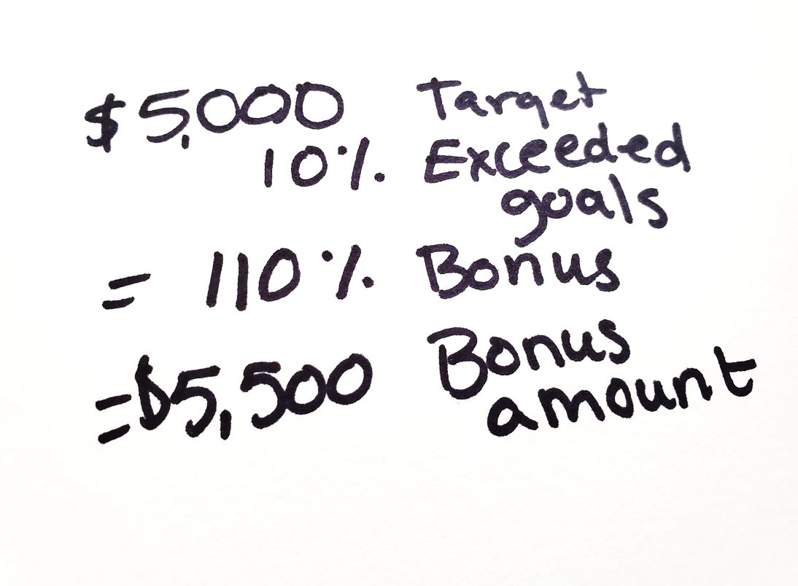
PERFORMANCE INCENTIVES
Incentives are variable compensation designed to reward high-performing team members who contribute to the firm’s success and who demonstrate a long-term commitment to the firm. It is not guaranteed and is not available to adviser positions as they are paid incentive compensation in the form of % of revenue managed.
Eligibility: Full-time, exempt employment, at least six months with the firm and satisfactory job performance
FIRM PERFORMANCE & INDIVIDUAL INCENTIVE
  Meeting firm goals and individual performance determine the bonus amount. Firm success and goals are set each year for:
    Profitability
    Net new revenue
    Client retention
  Each team member has target bonus for the year, which is funded based on firm performance
  The funded bonus is then paid out based on the team member’s individual performance and achievement of goals
  Bonuses are evaluated and paid annually
HOW IT WORKS
Amount Indv. Incentive Paid Based on Performance
Example:
Firm Performance
100% or up to
125% of target
50% - 100% of target
<50% Not funded
EXAMPLE 2
Notes:
This presentation includes two common examples for team member incentive compensation. These are the not the only forms available, so be sure to update this slide with how you have designed your incentive compensation program. Note that some firms opt to include adviser positions in individual and firm incentive and other firms do not since a % of revenue has a similar impact.

Slide 9
YOUR PERKS
WHAT ARE PERKS?
There is more to compensation than monetary benefits. Some of the additional perks you may receive while working here are:
HAVE AN IDEA FOR A COMPANY PERK? LET US KNOW.
Flexible / remote schedule with approval
½ day summer Fridays
On the spot recognitions
Company comfort fund (dedicated budget
to make team & office comfortable, submit requests for approval)
Fully stocked fridge (what’s your favorite beverage?)
Tab at cafe deli (within reason)
Eligibility: All team member are eligible for perks.
Notes:
Update to reflect your firm perks

Slide 10
WHAT DOES THIS MEAN TO YOU?
Your compensation is one important way we believe you deserve to be rewarded for dedicated work, a can-do attitude and a team-player mentality.
HOW IS MY COMPENSATION PAID?
  Base compensation is evaluated and adjusted annually based on experience, expertise, professional growth, performance and market conditions (when appropriate)
  Base compensation is paid 2x month
  Incentive compensation is paid annually in February, quarterly for adviser revenue share
WHAT IS MY COMPENSATION & HOW DO I GROW IT?
  You will receive an individual compensation summary each year that outlines your compensation
  We will review your performance, growth and development opportunities quarterly and each year
  Compensation grows when team members demonstrate significant increases in skill, experience and expertise in their role
  Position career ladders and discussions with your manager will define what it takes to move to the next level in your position or to be promoted
Notes:
Update to reflect how you pay and change compensation.

