Slide 1





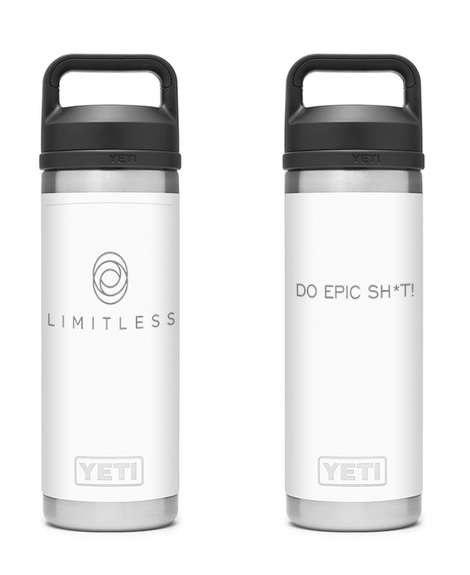

WELCOME
DECEMBER COACHING CALL
Take Your Survey: Drawing at end of call!
Who’s got on an ugly sweater?
FREE
Learning Lab

Slide 2

LIMITLESS COACHING CALL
December 13, 2021

Slide 3
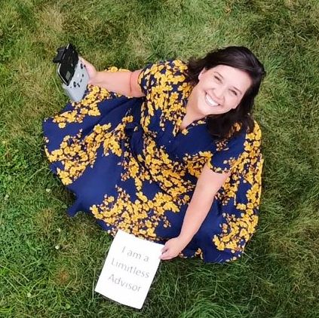
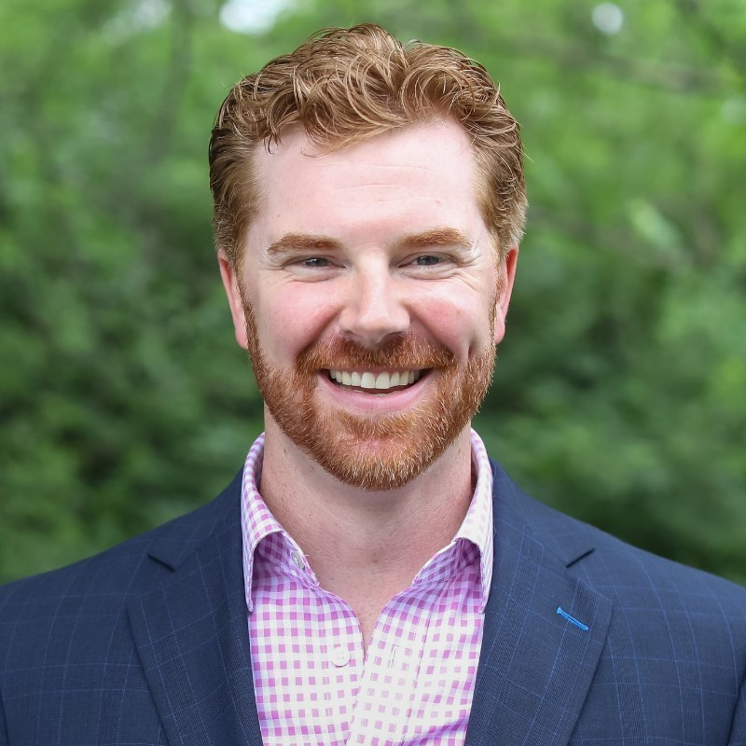
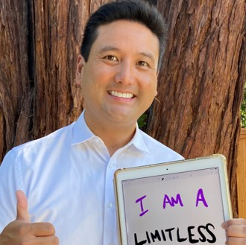
SUCCESS Spotlights
Liz Hand
Neal Albritton
Virg Cristobal
AUM
GROWTH
From $136M to $169M
From $82M to $100M
Jan ‘20: $56 M
Dec ‘21: $85M
REVENUE
GROWTH
$880K to $1.22M
$1.0M to $1.3M
(profit margin 28%)
2019: $366K
2021: $635K
Fridays Off
2 Week-long Family Vacations
Closed office 12/24-12/31
60 Days OO
½ Day Fridays
No client mtgs: June-Aug
Started Fridays off
DAYS OFF
HRS/WK
32 hours
Nearing 30-hr week
30 hours
(down from 45-50!)
Major mindset shift
For the black sheep of the industry
Hit weight goal of 215 lbs
Calm, collected & happy
Bought new family home
Transformed life
QOL
BIG WINS
Set minimum fee
Perfecting surges
Succession deal
Shifting to specialist practice
2021: Year of vision
2022: Year of growth
60 Ideal clients per advisor
Implemented surges
Launched new website & video
Segmented client service levels
EBOC ‘19: 35% - ‘21: 77%
Left B/D, went Indep RIA
Raised fees to market value
Focused niche: tech w/stock
Notes:
Conversation around what you did to “hone your steel”?
10 min each.
Cover #s first then, what are the levers that you each pull?

Slide 4

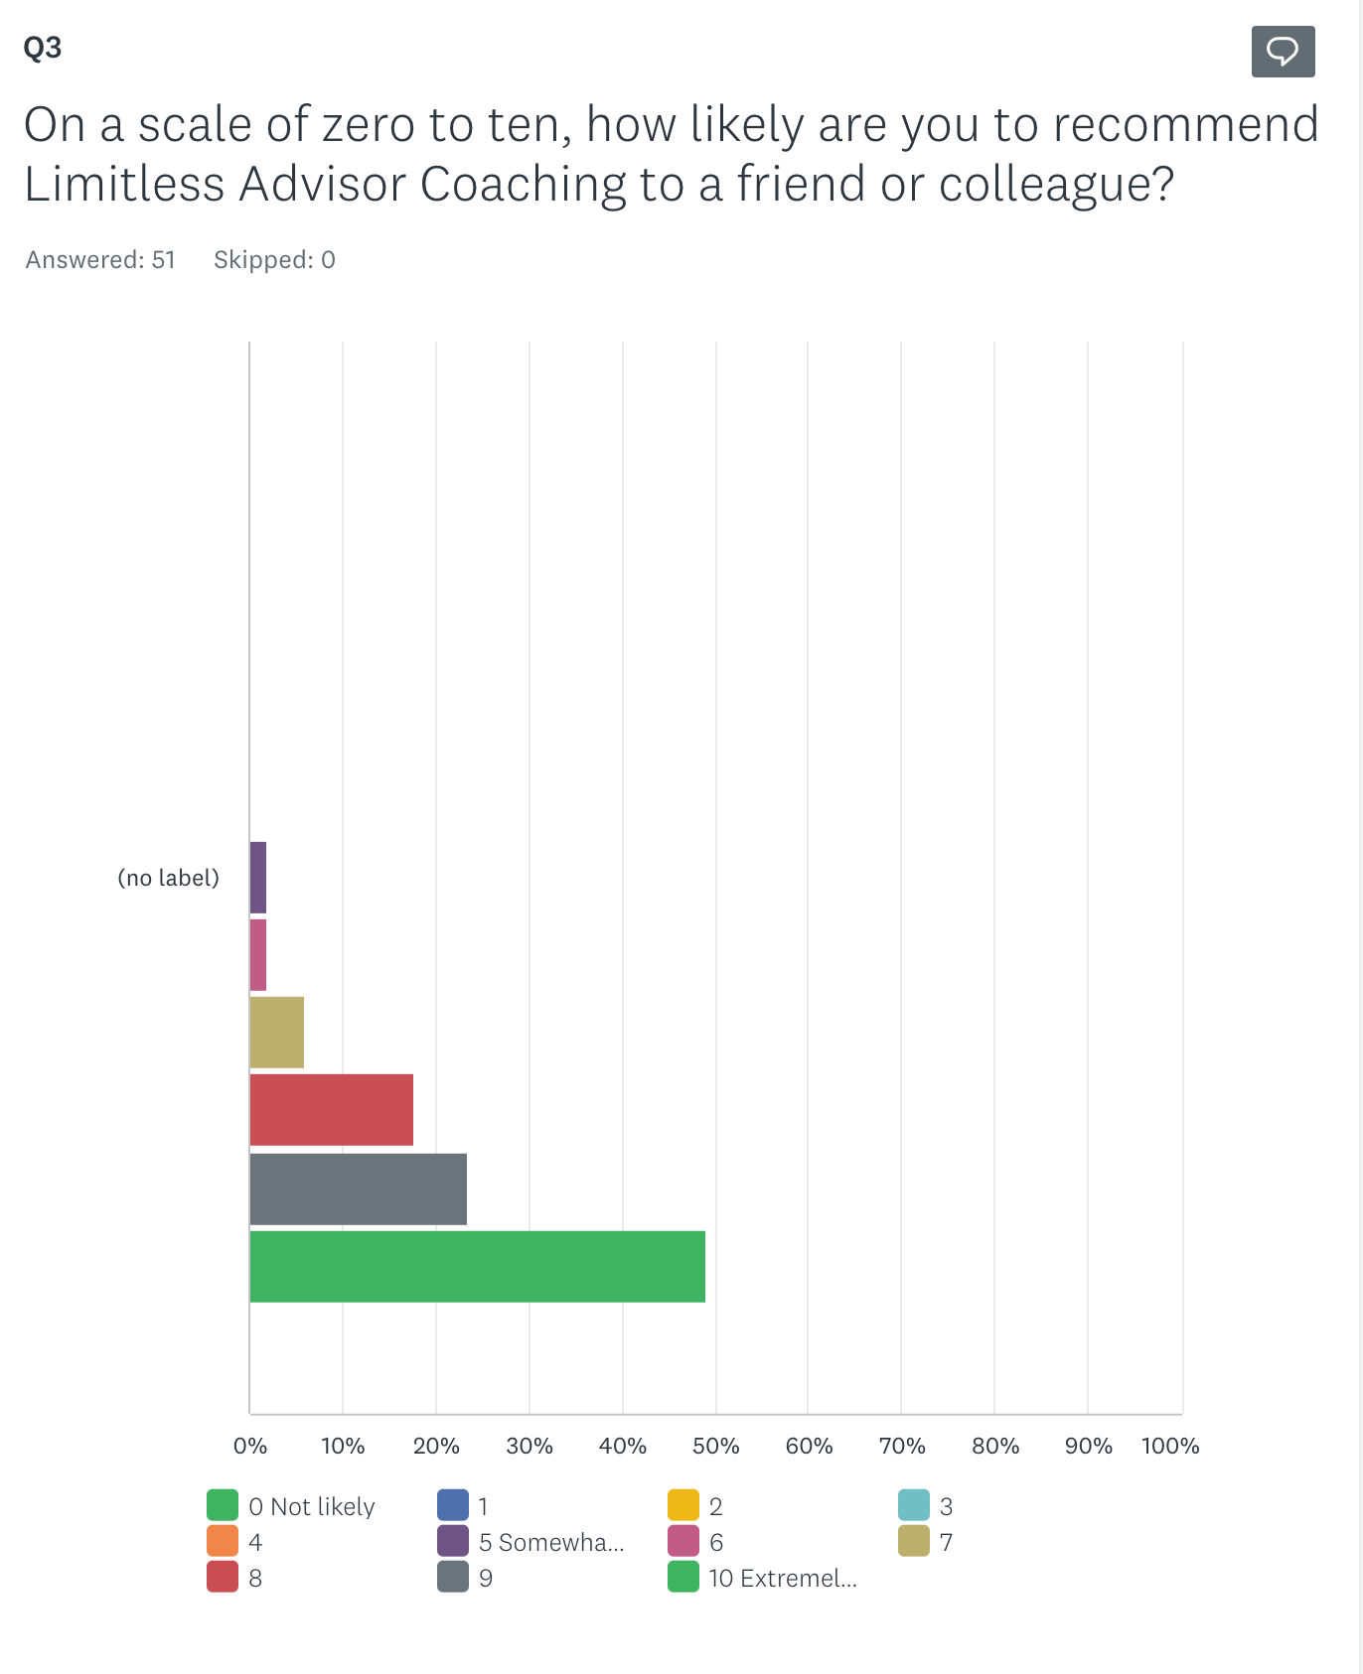

Survey Results
& Winners….
70-100 = WORLD CLASS
(and we’re committed to
continuous improvement)
World Class NPS scores (thank you!)
#1 Challenge: Focus (overwhelm)
What did we learn?
&
Learning Lab

Slide 5

Limitless Q&A
Notes:
Stay on for 2 minutes talking about their assignments for Inbox Insight now

